Slide 1
Operations and Productivity
1
Operations Strategy in a Global Environment
2

Slide 2
Operations Management
Production
Creation of goods and services
Operations management (OM)
Set of activities that create value in the form of goods and services by transforming inputs into outputs

Slide 3
Terminology
Operations Management
Operations
OM
Ops
Op Man
Warehouse guys
Construction Management
Etc…

Slide 4
Why Study OM?
OM is one of three major functions of any organization
How people organize themselves for a productive enterprise
Understand how OM fits in with these functions
How it relates to your major
Learn how goods and services are produced
Understand what operations managers do
OM is such a costly part of an organization

Slide 5
Three Major Functions
1. Marketing – generates demand
2. Operations – creates the product
3. Finance/accounting – tracks how well the organization is doing, pays bills, collects the money

Slide 6
Ten Strategic Decisions
TABLE 1.2
DECISION |  | CHAPTER(S)
1. Design of goods and services |  | 5, Supplement 5
2. Managing quality |  | 6, Supplement 6
3. Process and capacity strategy |  | 7, Supplement 7
4. Location strategy |  | 8
5. Layout strategy |  | 9
6. Human resources and job design |  | 10
7. Supply-chain management |  | 11, Supplement 11
8. Inventory management |  | 12, 14, 16
9. Scheduling |  | 13, 15
10. Maintenance |  | 17

Slide 7
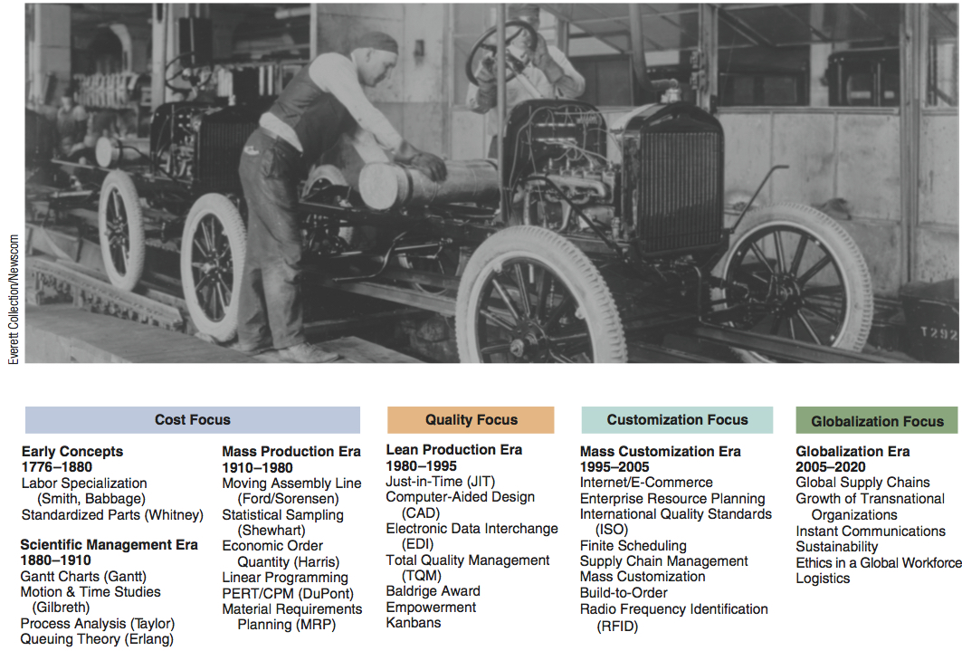
Significant Events
Figure 1.4

Slide 8
Very Brief History
Division of labor
Adam Smith 1776; Charles Babbage 1852
Standardized parts
Whitney 1800
Scientific Management
Taylor 1881
Coordinated assembly line
Ford/ Sorenson 1913
Gantt charts
Gantt 1916
Motion study
Frank and Lillian Gilbreth 1922
Quality control
Shewhart 1924; Deming 1950

Slide 9
Current Challenges
Globalization
Supply-chain partnering
Sustainability
Rapid product development
Mass customization
Lean operations

Slide 10
Goods vs. Services
TABLE 1.3
CHARACTERISTICS OF SERVICES |  | CHARACTERISTICS OF GOODS
Intangible: Ride in an airline seat |  | Tangible: The seat itself
Produced and consumed simultaneously: Beauty salon produces a haircut that is consumed as it is produced |  | Product can usually be kept in inventory (beauty care products)
Unique: Your investments and medical care are unique |  | Similar products produced (iPods)
High customer interaction: Often what the customer is paying for (consulting, education) |  | Limited customer involvement in production
Inconsistent product definition: Auto Insurance changes with age and type of car |  | Product standardized (iPhone)
Often knowledge based: Legal, education, and medical services are hard to automate |  | Standard tangible product tends to make automation feasible
Services dispersed: Service may occur at retail store, local office, house call, or via internet. |  | Product typically produced at a fixed facility
Quality may be hard to evaluate: Consulting, education, and medical services |  | Many aspects of quality for tangible products are easy to evaluate (strength of a bolt)
Reselling is unusual: Musical concert or medical care |  | Product often has some residual value

Slide 11
Productivity Challenge
Productivity is the ratio of outputs (goods and services) divided by the inputs (resources such as labor and capital)
The objective is to improve productivity!
Important Note!
Production is a measure of output only and not a measure of efficiency

Slide 12
Productivity
Units produced
Input used
Productivity =
Measure of process improvement
Represents output relative to input
Only through productivity increases can our standard of living improve

Slide 13
Productivity Calculations
Labor Productivity
Units produced
Labor-hours used
Productivity =
1,000
250
= = 4 units/labor-hour
One resource input ⇨ single-factor productivity

Slide 14
Multi-Factor Productivity
Output
Labor + Material + Energy + Capital + Miscellaneous
Multifactor =
Also known as total factor productivity
Output and inputs are often expressed in dollars
Multiple resource inputs ⇨ multi-factor productivity

Slide 15
Collins Title Productivity
Old System:
Staff of 4 works 8 hrs/day 8 titles/day
Payroll cost = $640/day Overhead = $400/day
8 titles/day
32 labor-hrs
Old labor productivity
=
= 0.25 titles/labor-hr

Slide 16
Collins Title Productivity
Old System:
Staff of 4 works 8 hrs/day 8 titles/day
Payroll cost = $640/day Overhead = $400/day
New System:
14 titles/day Overhead = $800/day
8 titles/day
32 labor-hrs
Old labor productivity
=
= 0.25 titles/labor-hr
14 titles/day
32 labor-hrs
New labor productivity
=
= 0.44 titles/labor-hr

Slide 17
Collins Title Productivity
Old System:
Staff of 4 works 8 hrs/day 8 titles/day
Payroll cost = $640/day Overhead = $400/day
New System:
14 titles/day Overhead = $800/day
8 titles/day
$640 + 400
Old multifactor productivity
=
= 0.0077 titles/dollar

Slide 18
Collins Title Productivity
Old System:
Staff of 4 works 8 hrs/day 8 titles/day
Payroll cost = $640/day Overhead = $400/day
New System:
14 titles/day Overhead = $800/day
8 titles/day
$640 + 400
Old multifactor productivity
=
= 0.0077 titles/dollar
14 titles/day
$640 + 800
New multifactor productivity
=
= 0.0097 titles/dollar

Slide 19
Measurement Problems
Quality may change while the quantity of inputs and outputs remains constant
External elements may cause an increase or decrease in productivity
Precise units of measure may be lacking

Slide 20
Practice Problem
Chuck Sox makes wooden boxes in which to ship motorcycles. Chuck and his three employees invest a total of 30 hours per day making the 400 boxes.
​Their productivity​ = __.__ ​boxes/hour ​(round your response to two decimal​ places).
Chuck and his employees have discussed redesigning the process to improve efficiency. Suppose they can increase the rate to 500 boxes per day.
Their new productivity​ = __.__ ​boxes/hour ​(round your response to two decimal​ places).
​The unit increase in productivity is __.__ ​boxes/hour ​(round your response to two decimal​ places).
​The percentage LOADING... increase in productivity is __.__​% ​(enter your response as a percentage rounded to two decimal​ places).

Slide 21
Practice Problem - SOL
Chuck Sox makes wooden boxes in which to ship motorcycles. Chuck and his three employees invest a total of 30 hours per day making the 400 boxes.
​Their productivity​ = 13.33 ​boxes/hour ​(round your response to two decimal​ places).
Chuck and his employees have discussed redesigning the process to improve efficiency. Suppose they can increase the rate to 500 boxes per day.
Their new productivity​ = 16.67 ​boxes/hour ​(round your response to two decimal​ places).
​The unit increase in productivity is 3.33 ​boxes/hour ​(round your response to two decimal​ places).
​The percentage LOADING... increase in productivity is 25​% ​(enter your response as a percentage rounded to nearest whole number).

Slide 22
Developing Missions and Strategies
Mission statements
Tell an organization where it is going
Strategy
Tells the organization how to get there

Slide 23
Mission
Where is the organization going?
Organization’s purpose for being
Provides boundaries and focus
Answers
“What do we contribute to society?”

Slide 24
Factors Affecting Mission
Philosophy and Values
Profitability and Growth
Environment
Mission
Customers
Public Image
Benefit to Society

Slide 25
Strategy
Action plan to achieve mission
Functional areas have strategies
Strategies
Exploit opportunities and strengths
Neutralize threats
Avoid weaknesses

Slide 26
Competitive Advantage Strategies
Differentiation
Better, or at least different
Cost leadership
Cheaper
Response
More responsive

Slide 27
Competing on Differentiation
Uniqueness can go beyond both the physical characteristics and service attributes to encompass everything that impacts customer's perception of value
Safeskin gloves – leading edge products
Walt Disney Magic Kingdom – experience differentiation
Hard Rock Cafe – dining experience

Slide 28
Experience Differentiation
Engaging a customer with a product through imaginative use of the five senses, so the customer “experiences” the product
Theme parks use sight, sound, smell, and participation
Movie theatres use sight, sound, moving seats, smells, and mists of rain
Restaurants use music, smell, and open kitchens

Slide 29
Competing on Cost
Provide the maximum value as perceived by customer
Does not imply low quality
Southwest Airlines – secondary airports, no frills service, efficient utilization of equipment
Walmart – small overhead, shrinkage, and distribution costs
Franz Colruyt – no bags, no bright lights, no music, and doors on freezers

Slide 30
Competing on Response
Flexibility is matching market changes in design innovation and volumes
A way of life at Hewlett-Packard
Reliability is meeting schedules
German machine industry
Quickness in design, production, and delivery
Pizza Hut

Slide 31
OM’s Contribution to Strategy
10 Operations Competitive
Decisions Strategy Example Advantage
Product
Quality
Process
Location
Layout
Human resource
Supply chain
Inventory
Scheduling
Maintenance
DIFFERENTIATION:
Innovative design ………... Safeskin’s innovative gloves
Broad product line ……… Fidelity Security’s mutual funds
After-sales service …….. Caterpillar’s heavy equipment service
Experience …………….. Hard Rock Café’s dining experience
COST LEADERSHIP:
Low overhead ……… Franz-Colruyt’s warehouse-type stores
Effective capacity … Southwest Airline’s
use aircraft utilization
Inventory ……………. Walmart’s sophisticated
management distribution system
RESPONSE:
Flexibility …………….. Hewlett-Packard’s response to volatile world market
Reliability ……………… FedEx’s “absolutely, positively, on time”
Quickness ………………. Pizza Hut’s 5-minute guarantee at lunchtime
Differentiation
(better)
Cost leadership
(cheaper)
Response
(faster)
Figure 2.4

Slide 32
Product Life Cycle
Introduction Growth Maturity Decline
Best period to increase market share
R&D engineering is critical
Practical to change price or quality image
Strengthen niche
Poor time to change image, price, or quality
Competitive costs become critical
Defend market position
Cost control critical
Company Strategy/Issues
Hybrid engine vehicles
Laptop computers
Boeing 787
Xbox One
3D printers
DVDs
Life Cycle Curve
Electric vehicles
Apple SmartWatch
3-D game players
Video physical rentals
Figure 2.5

Slide 33
Product Life Cycle
Introduction Growth Maturity Decline
Introduction Growth Maturity Decline
Product design and development critical
Frequent product and process design changes
Short production runs
High production costs
Limited models
Attention to quality
Forecasting critical
Product and process reliability
Competitive product improvements and options
Increase capacity
Shift toward product focus
Enhance distribution
Standardization
Fewer rapid product changes, more minor changes
Optimum capacity
Increasing stability of process
Long production runs
Product improvement and cost cutting
Little product differentiation
Cost minimization
Overcapacity in the industry
Prune line to eliminate items not returning good margin
Reduce capacity
OM Strategy/Issues
OM Strategy/Issues
Figure 2.5

Slide 34
SWOT Analysis
Mission
Internal Strengths
External Opportunities
Analysis
Internal Weaknesses
External Threats
Strategy

Slide 35
Strategy Development Process
Analyze the Environment
Identify the strengths, weaknesses, opportunities, and threats. Understand the environment, customers, industry, and competitors.
Determine the Corporate Mission
State the reason for the firm’s existence and identify the value it wishes to create.
Form a Strategy
Build a competitive advantage, such as low price, design, or volume flexibility, quality, quick delivery, dependability, after-sale service, broad product lines.
Figure 2.6

Slide 36
Strategy Development and Implementation
Identify key success factors
Integrate OM with other activities
Build and staff the organization
The operations manager’s job is to implement an OM strategy, provide competitive advantage, and increase productivity

